Slide 1


Drops of LTSpice
Calculate
Heat Dissipation

Slide 2
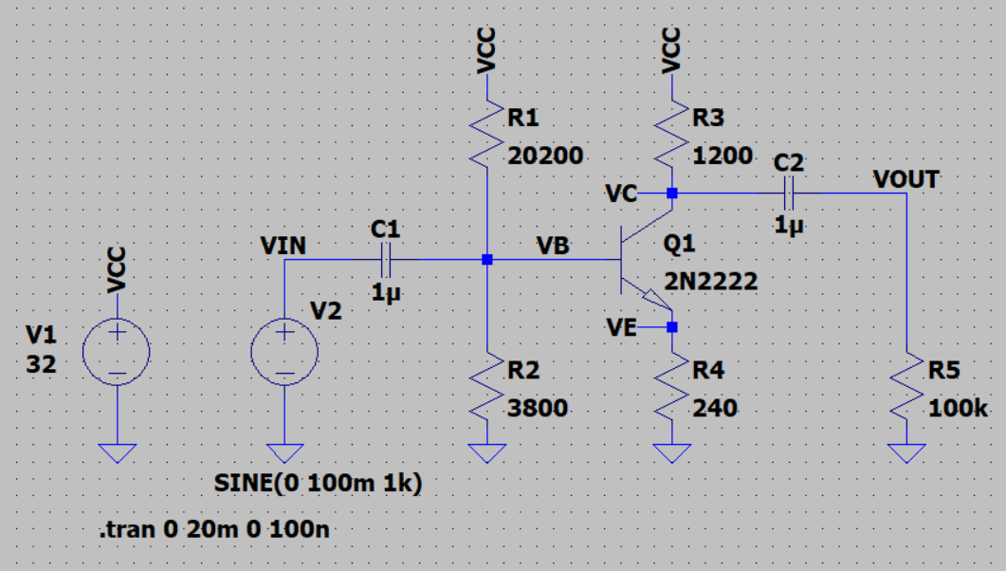
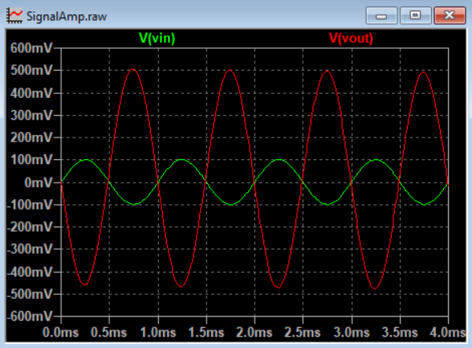
So, you've built an amplifier.
And it is working properly.

Slide 3
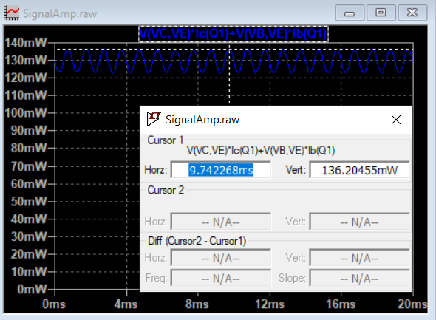
But how much power is it dissipating?
We already know how to plot this.
The maximum power is 136.21mW.

Slide 4

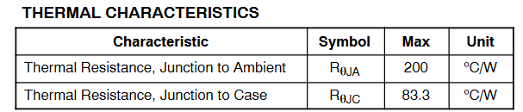
Checking the datasheet and doing some math, the junction temperature is…
T_{J} = P_{MAX} x R_{ϴ} + T_{A}
T_{J} = ( 136.21 x 10⁻³ x 200 ) + 25 = 52.24⁰C
Easy, isn't it?

Slide 5

But, couldn't we take advantage of LTSpice to do this for us?
Yes, we can do that!
First, we need understand how to transform thermal dissipation into an electronic circuit.

Slide 6
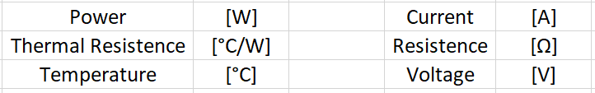
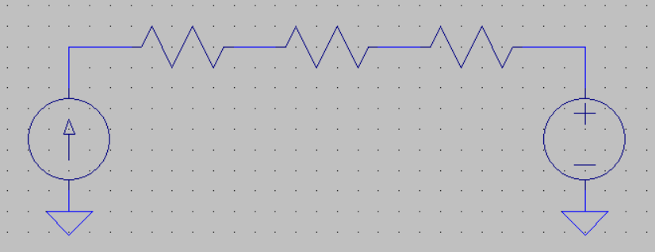
The flow of temperature is like the flow of direct current. So, we can consider this conversion:
And the circuit is simple:
Junction Temperature
Ambient
Temperature
R_{JC}
R_{CH}
R_{HA}

Slide 7
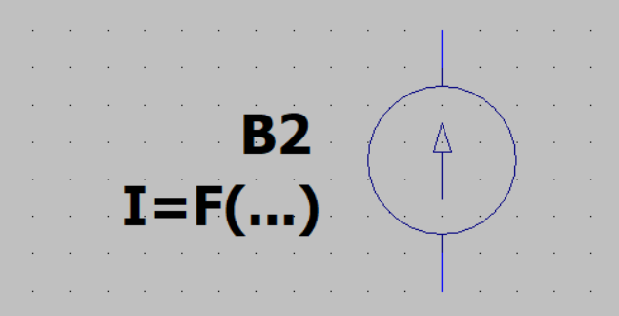
The secret to assembling this circuit in LTSpice is the Arbitrary Behavioral Current Source.
It allows you to create a current source numerically equal to the power of the transistor.

Slide 8
For our circuit, this is the formula.
As we are using 2N2222 in the TO92 package, we only have one thermal resistance.
Let's use R_{ϴJA}, which is the thermal resistance of the Junction to the Ambient.

Slide 9
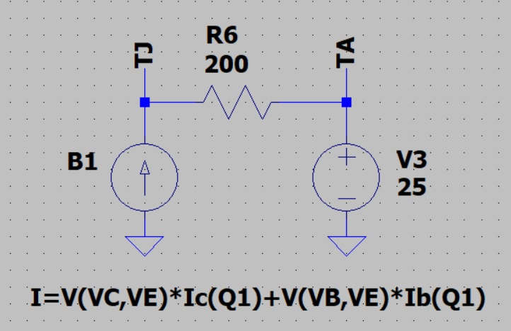
And this is the circuit that simulates the Junction temperature.
Keep in mind that we converted temperature [⁰C] to Volts, so we are interested in the voltage across the junction.

Slide 10
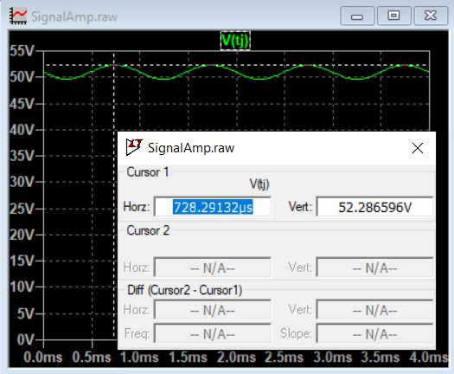
As we can see, the circuit agrees with the calculation.
The 52V in T_{J} is the 52⁰C on the junction.
Francesco Sacco
linkedin.com/in/saccofrancesco

